Slide 1




THE HAT HUB: PREMIER HAT FASHION DESTINATION
ISTE.230 .600 - Intro To Database And Data Modeling
Team Members (Group 3): Afra Ibrahim - Jude Abdel Halim - Kassem Darawch - Muaz Osman - Wassem Qaffaf
Instructed by: Dr. Marwan Al-Tawil
Date: 28 November, 2023

Slide 2
TEAM MANIFESTO
Team Member | Contributions
Waseem Qaffaf | Database Schema Design, Writing the Python code for interface integration
Jude Abdel Halim | E-R Diagram Creation, Relationship between entities, Project Documentation Formatting
Muaz Osman | Business scenario, Writing of the SQL Queries, DDL Commands, and DML Commands
Afra Mustafa | Key Users Tasks, Normalization and Transposition, Project Compilation
Kassem Darawcha | Algebra Notations and Operations

Slide 3
TABLE OF CONTENTS
01 - PHASE I: CONCEPTUAL AND LOGICAL DESIGN
04 - TRANSPOSITION AND NORMALIZATION
02 - ENTITY AND RELATIONSHIP IDENTIFICATION
05 - PHASE II: PHYSICAL DESIGN
03 - E-R DIAGRAM CREATION
06 - ALGEBRA NOTATIONS
07 - BONUS DEMONESTARTION

Slide 4
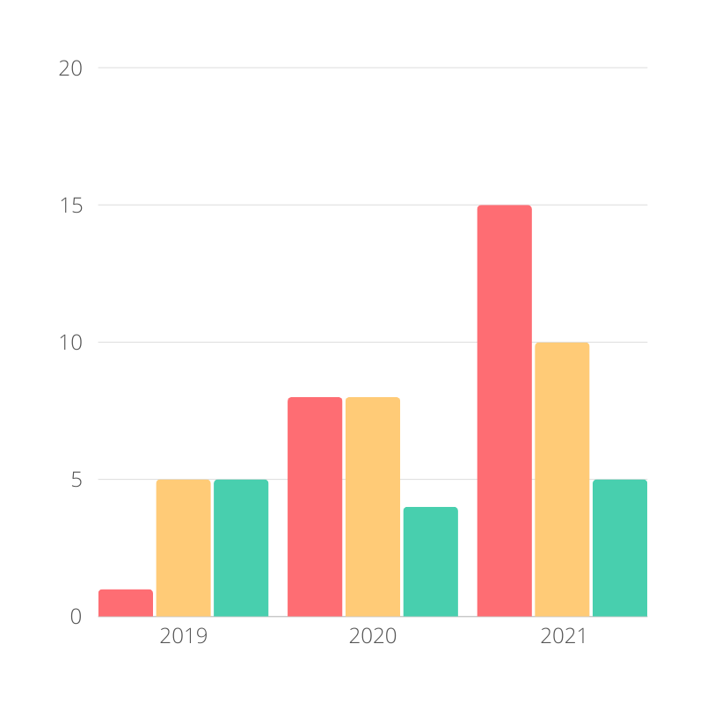
SCENARIO
"The Hat Hub," a hat retailer with online stores, currently relies on manual paper-based systems for sales, inventory, and customer data. To address efficiency challenges and accommodate growth, implementing a structured database is essential. The database will streamline tasks such as logging sales, managing real-time inventory, handling customer information, and generating insightful sales reports. This solution aims to enhance operational efficiency, ensuring a more organized and scalable approach for "The Hat Hub's" expanding business.

Slide 5
List of Entities
Customers
Bills
Orders
Delivery
Hats
Entities Attributes
Customers (customer_id (PK), name, DOB, email, contact_info, address)
Bills (bill_id (PK), order_id (FK), tax, price, payment_method)
Orders (order_id (PK), customer_id (FK), hat_id (FK), date, quantity)
Delivery (delivery_id (PK), order_id (FK), arrival_date)
Hats (hat_id (PK), brand_id, price, brand_name, style, size, quantity)

Slide 6
RELATIONSHIPS BETWEEN ENTITIES
Relationship Name: Place / Placed by
Relationship type: one-to-many
Degree: Binary
Description: A customer places one or more orders, and an order is placed by one customer.
Minimum Cardinality: One customer can place zero or more orders (0..N).
Maximum Cardinality: There is no strict maximum limit to the number of orders a customer can place, but an order is placed by only one customer.
CUSTOMERS - ORDERS
Relationship Name: Linked / Linked by
Relationship type: many-to-many
Degree: Binary
Description: An order is linked to one or more hats, and a hat is linked to one or more orders.
Minimum Cardinality: One order can include zero or more hats (0..N)
Maximum Cardinality: There is no strict maximum limit to the number of hats linked to an order, and a hat can be linked to multiple orders.
ORDERS - HATS

Slide 7
RELATIONSHIPS BETWEEN ENTITIES
Relationship Name: Has
Relationship type: one-to-one
Degree: Binary
Description: An order has one delivery, and a delivery is associated with one order.
Minimum Cardinality: One order has zero or one delivery (0..1).
Maximum Cardinality: Each order has one associated delivery, and each delivery is associated with one order.
ORDERS - DELIVERY
Relationship Name: Generates / Generated by
Relationship type: one-to-one
Degree: Binary
Description: An order generates one bill, and a bill is generated by one order.
Minimum Cardinality: One order generates one bill (1..1).
Maximum Cardinality: Each order generates one bill, and each bill is generated by one order.
ORDERS - BILLS

Slide 8
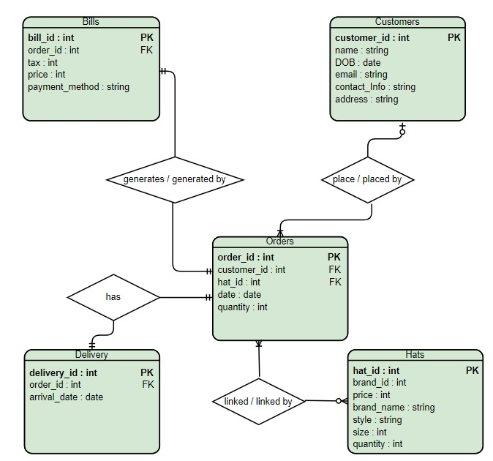
E-R DIAGRAM

Slide 9
TRANSPOSITION
Customers (customer_id, name, DOB, email, contact_info, address)
Hats (hat_id, brand_id, brand_name, style, size, quantity)
Orders (order_id, customer_id, hat_id, date, quantity)
customer_id MEI Customers(customer_id)
hat_id MEI Hats(hat_id)
Bills (bill_id, order_id, tax, price, payment_method)
order_id MEI Orders(order_id)
Delivery (delivery_id, order_id, arrival_date)
order_id MEI Orders(order_id)

Slide 10
FIRST NORMAL FORM (1ST NF)
Hats (hat_id, brand_id, price, brand_name)
Hats_stocks (hat_id, color, size,style, quantity)
hat_id MEI Hats(hat_id)
Customers (customer_id , name, DOB, email, contact_info, address)
Orders (order_id, customer_id, date, quantity)
customer_id MEI Customers(customer_id)
Order_Details (order_id , hat_id, quantity)
hat_id MEI Hats(hat_id)
order_id MEI Orders(order_id)
Bills (bill_id, order_id, tax, price, payment_method)
order_id MEI Orders(order_id)
Delivery (delivery_id, order_id, arrival_date)
order_id MEI Orders(order_id)

Slide 11
SECOND NORMAL FORM (2ND NF)
Hats (hat_id, brand_id, price, brand_name)
Hats_stocks (hat_id, color, size,style, quantity)
hat_id MEI Hats(hat_id)
Customers (customer_id , name, DOB, email, contact_info, address)
Orders (order_id, customer_id, date, quantity)
customer_id MEI Customers(customer_id)
Order_Details (order_id , hat_id, quantity)
hat_id MEI Hats(hat_id)
order_id MEI Orders(order_id)
Bills (bill_id, order_id, tax, price, payment_method)
order_id MEI Orders(order_id)
Delivery (delivery_id, order_id, arrival_date)
order_id MEI Orders(order_id)

Slide 12
THIRD NORMAL FORM (3RD NF)
Brands (brand_id, brand_name)
Hats (hat_id, brand_id, price)
brand_id MEI Brands(brand_id)
Hats_stocks (hat_id, color, size,style, quantity)
hat_id MEI Hats(hat_id)
Customers (customer_id , name, DOB, email, contact_info, address)
Orders (order_id, customer_id, date, quantity)
customer_id MEI Customers(customer_id)
Order_Details (order_id , hat_id, quantity)
hat_id MEI Hats(hat_id)
order_id MEI Orders(order_id)
Bills (bill_id, order_id, tax, price, payment_method)
order_id MEI Orders(order_id)
Delivery (delivery_id, order_id, arrival_date)
order_id MEI Orders(order_id)

Slide 13
DDL COMMANDS
-- Creating the table for Customers
CREATE TABLE Customers (
customer_id INT PRIMARY KEY NOT NULL,
name VARCHAR(255) NOT NULL,
DOB DATE NOT NULL,
email VARCHAR(255) NOT NULL,
contact_info VARCHAR(255),
address VARCHAR(255) NOT NULL);
-- Creating the table for Hats first, because it is referenced by other tables
CREATE TABLE Hats (
hat_id INT PRIMARY KEY NOT NULL,
brand_id INT NOT NULL,
price DECIMAL(10,2) NOT NULL,
brand_name VARCHAR(255) NOT NULL,
style VARCHAR(255) NOT NULL,
size INT NOT NULL,
quantity INT NOT NULL);
-- Creating the table for Orders after Hats table has been created
CREATE TABLE Orders (
order_id INT PRIMARY KEY NOT NULL,
customer_id INT NOT NULL,
hat_id INT NOT NULL,
date DATE NOT NULL,
quantity INT NOT NULL,
FOREIGN KEY (customer_id) REFERENCES Customers(customer_id),
FOREIGN KEY (hat_id) REFERENCES Hats(hat_id));
-- Creating the table for Delivery
CREATE TABLE Delivery (
delivery_id INT PRIMARY KEY NOT NULL,
order_id INT NOT NULL,
arrival_date DATE,
FOREIGN KEY (order_id) REFERENCES Orders(order_id)
);
-- Creating the table for Bills
CREATE TABLE Bills (
bill_id INT PRIMARY KEY NOT NULL,
order_id INT NOT NULL,
tax DECIMAL(10,2) NOT NULL,
price DECIMAL(10,2) NOT NULL,
payment_method VARCHAR(255) NOT NULL,
FOREIGN KEY (order_id) REFERENCES Orders(order_id)
);
-- Creating an associative table for the many-to-many relationship between Orders and Hats
CREATE TABLE Order_Details (
order_id INT NOT NULL,
hat_id INT NOT NULL,
quantity INT NOT NULL,
PRIMARY KEY (order_id, hat_id),
FOREIGN KEY (order_id) REFERENCES Orders(order_id),
FOREIGN KEY (hat_id) REFERENCES Hats(hat_id)
);

Slide 14
SQL DML SAMPLE RECORDS
-- Inserting sample records into Customers
INSERT INTO Customers (customer_id, name, DOB, email, contact_info, address) VALUES
(1, 'Kassem', '1985-04-12', 'kassem@email.com', '555-1234', '123 Street'),
(2, 'Waseem', '1990-08-25', 'waseem@email.com', '555-5678', '456 Oak Avenue'),
(3, 'Muaz', '1995-02-06', 'muaz@email.com', '555-6589', '789 Pine Road'),
(4, 'Afra', '1970-01-03', 'Afra@email.com', '555-4853', '658 Cashew Road'),
(5, 'Jude', '1975-02-03', 'jude@email.com', '555-9854', '452 Almond Road');
-- Inserting sample records into Hats
INSERT INTO Hats (hat_id, brand_id, price, brand_name, style, size, quantity) VALUES
(1, 101, 19.99, 'Nike', 'fedora', 7, 10),
(2, 102, 29.99, 'Adidas', 'beanie', 6, 15),
(3, 103, 24.99, 'PUMA', 'baseball', 7, 20);
-- Inserting sample records into Orders
INSERT INTO Orders (order_id, customer_id, hat_id, date, quantity) VALUES
(1, 1, 1, '2023-01-15', 2),
(2, 2, 2, '2023-02-20', 1),
(3, 3, 3, '2023-03-10', 3);
-- Inserting sample records into Delivery
INSERT INTO Delivery (delivery_id, order_id, arrival_date) VALUES
(1, 1, '2023-01-20'),
(2, 2, '2023-02-25');
-- Inserting sample records into Bills
INSERT INTO Bills (bill_id, order_id, tax, price, payment_method) VALUES
(1, 1, 1.50, 39.98, 'credit card'),
(2, 2, 2.25, 29.99, 'credit card'),
(3, 3, 1.80, 74.97, 'debit card');
-- Inserting sample records into Order_Details for many-to-many relationship including quantity
INSERT INTO Order_Details (order_id, hat_id, quantity) VALUES
(1, 1, 2), -- Assuming order 1 includes 2 of hat 1
(2, 2, 1), -- Assuming order 2 includes 1 of hat 2
(3, 3, 3), -- Assuming order 3 includes 3 of hat 3
(3, 1, 1); -- Assuming order 3 includes 1 of hat 1

Slide 15
SQL QUERIES
Query 1: DELETE using IS NULL
This query would delete records from the Hats table where the Quantity is NULL
DELETE FROM Hats WHERE quantity IS NULL;
Query 3: SELECT with UNION ALL
This query selects all records from both Hats and Orders tables. It combines all records, including duplicates.
SELECT * FROM Hats UNION ALL SELECT * FROM Orders;
Query 2: SELECT with INNER JOIN and LIKE
This query retrieves all records that join the Hats and Order_Details tables based on a condition that involves a text pattern (LIKE).
SELECT * FROM Hats INNER JOIN Order_Details ON Hats.hat_id = Order_Details.hat_id WHERE Hats.style LIKE 'fedo%';
Query 4: SELECT with EXISTS and subquery
This query selects the brand_name from Hats where there exists a corresponding entry in the Order_Details table with a quantity less than 5.
SELECT brand_name FROM Hats WHERE EXISTS ( SELECT * FROM Order_Details WHERE Hats.hat_id = Order_Details.hat_id AND quantity < 5);

Slide 16
Algebra Notations
Example Query:
Retrieve a list of all bills with the customer's name, bill ID, and total price for orders placed by customers who have purchased hats from the brand named "Hat Hub”

Slide 17
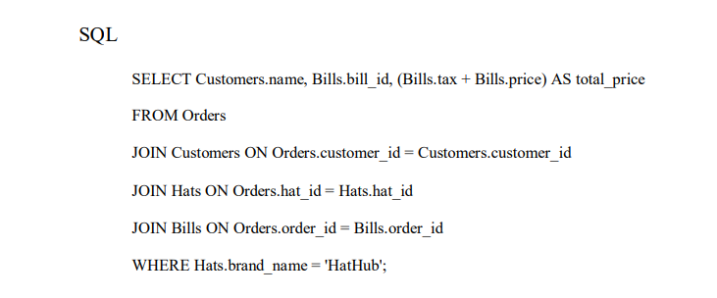
a. Projection, Selection, and Joins

Slide 18
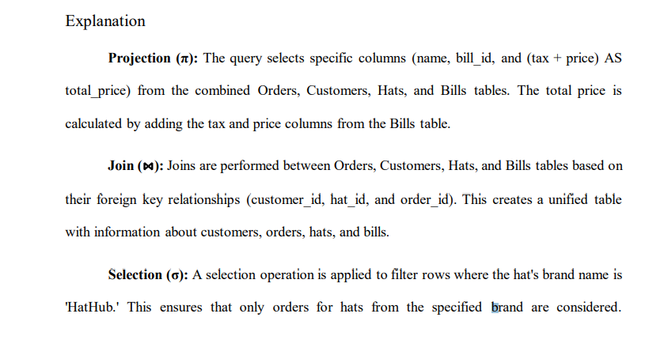
a. Projection, Selection, and Joins

Slide 19
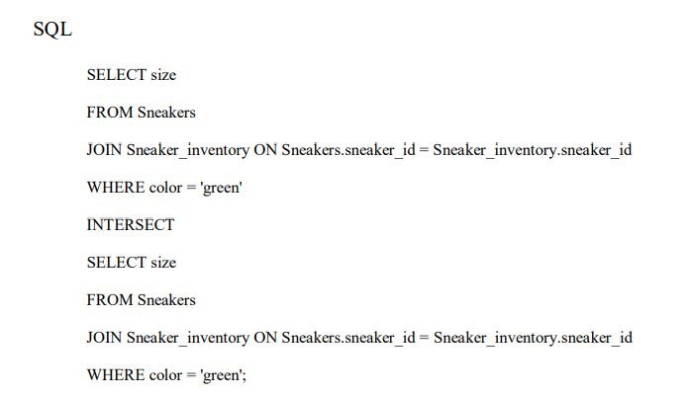
b. Union, Intersection, and Selection:
SQL

Slide 20
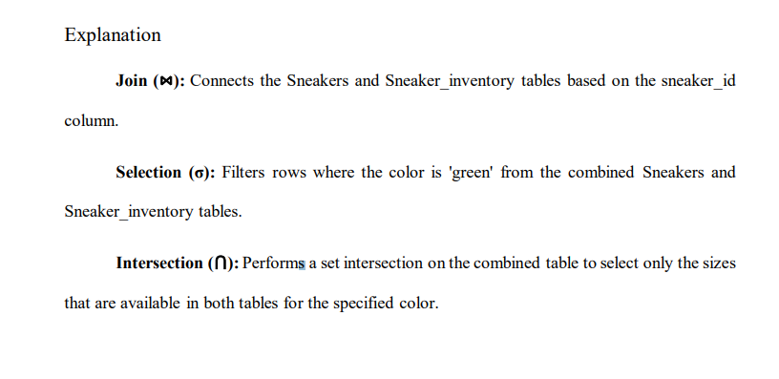
b. Union, Intersection, and Selection:
SQL

Slide 21
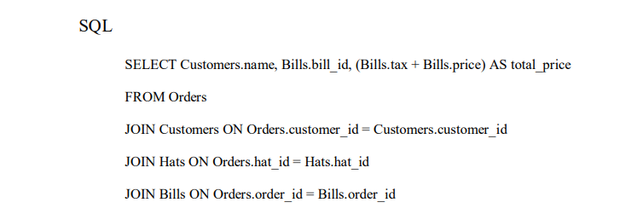
c. Projection, Union, and Joins
SQL

Slide 22
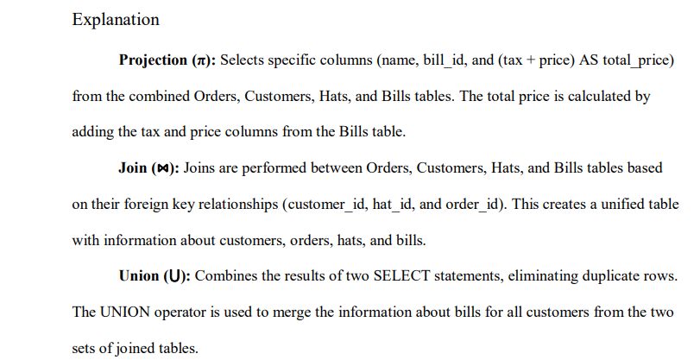
c. Projection, Union, and Joins
SQL

Slide 23
BONUS DEMONESTARTION

Slide 24
THANK YOU

